Slide 1
Classification Model II Decision Trees
Dr. Sugata Ghosal
CSIS Off-Campus Faculty
BITS Pilani

Slide 2
Segment Content
Introduction
Characteristics
Entropy and Information gain
Decision Tree Construction

Slide 3
Decision trees
Decision Trees is one of the most widely used and practical methods of classification
Method for approximating discrete-valued functions
Learned functions are represented as decision trees (or if-then-else rules)
Expressive hypotheses space

Slide 4
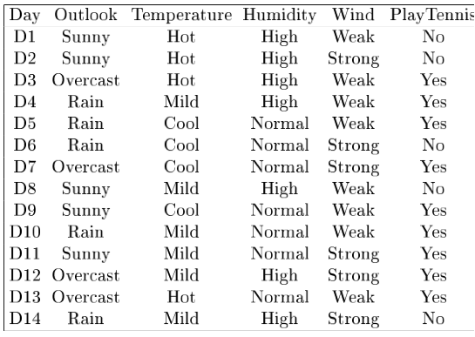
Example
Notes:
Target attrbute = playtennis

Slide 5
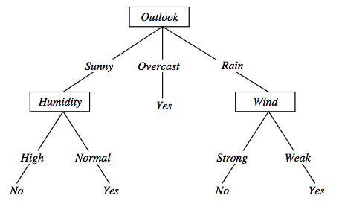
Decision tree representation (PlayTennis)
〈Outlook=Sunny, Temp=Hot, Humidity=High, Wind=Strong〉? No
Notes:
Each node represents a test on an attribute of the instance to be classified and each outgoing arch a possible outcome, leading to a further test.
The leafs correspond to classification actions. A binary classification in this case.
The instance <Outlook=Sunny, Temp=Hot, Humidity=High, Wind=Strong> is classified as No.

Slide 6
Decision trees expressivity
Decision trees represent a disjunction of conjunctions on constraints on the value of attributes
(Outlook = Sunny ∧ Humidity = Normal) ∨
(Outlook = Overcast) ∨
(Outlook = Rain ∧ Wind = Weak)

Slide 7
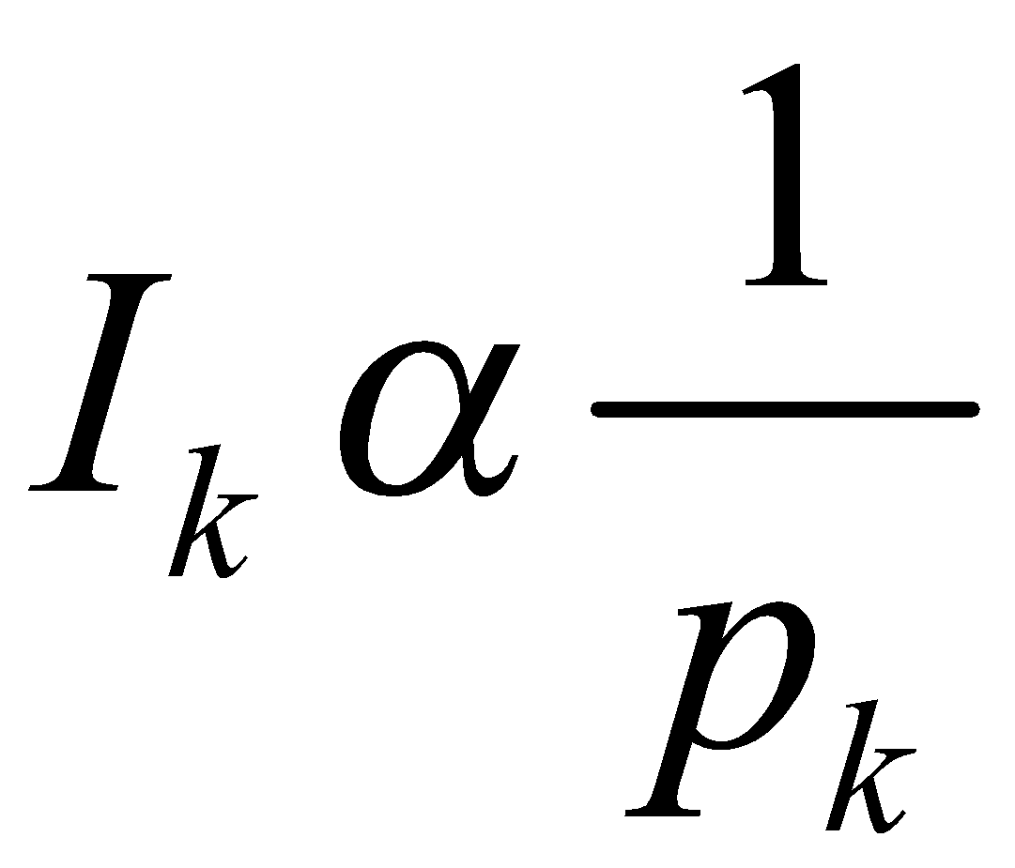
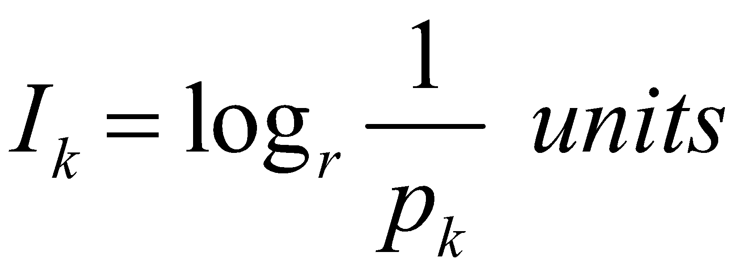
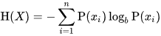
Measure of Information and Entropy
The amount of information (surprise element) conveyed by a message is inversely proportional to its probability of occurrence. That is
The mathematical operator satisfies above properties is the logarithmic operator.
Entropy of discrete random variable X={x₁, x₂…x_{n}}
since: log₂(1/P(event))= -log₂P(event)
As uncertainty increases, entropy increases
Entropy across all values

Slide 8
Entropy in general
Entropy measures the amount of information in a random variable
For binary classification [two-valued random variable]
H(X) = – p₊ log₂ p₊ – p– log₂ p– X = {+, –}
For classification in c classes
c c
H(X) = – Σ p_{i} log₂ p_{i} = Σ p_{i} log₂ 1/ p_{i} X = {i, …, c}
i=1 i=1

Slide 9
Entropy in binary classification
Entropy measures the impurity of a collection of examples. It depends from the distribution of the random variable p.
S is a collection of training examples
p₊ the proportion of positive examples in S
p– the proportion of negative examples in S
Entropy (S) ≡ – p₊ log₂ p₊ – p–log₂ p– [0 log₂0 = 0]
Entropy ([14+, 0–]) = – 14/14 log₂ (14/14) – 0 log₂ (0) = 0
Entropy ([9+, 5–]) = – 9/14 log₂ (9/14) – 5/14 log₂ (5/14) = 0.94
Entropy ([7+, 7– ]) = – 7/14 log₂ (7/14) – 7/14 log₂ (7/14) = 1/2 + 1/2 = 1
Note: the log of a number < 1 is negative, 0 ≤ p ≤ 1, 0 ≤ entropy ≤ 1
Notes:
S=[9+, 5-] una collezione di esempi di cui 9 positivi e 5 negativi

Slide 10
Information gain as entropy reduction
Information gain is the expected reduction in entropy caused by partitioning the examples on an attribute.
The higher the information gain the more effective the attribute in classifying training data.
Expected reduction in entropy knowing A
Gain(S, A) = Entropy(S) − Σ Entropy(S_{v})
v ∈ values(A)
values(A) possible values for A
S_{v} subset of S for which A has value v
|Sv|
|S|
Notes:
La riduzione in entropia attesa partizionando sui valori dell’ attributo A

Slide 11
Example: Information gain
Let
Values(Wind) = {Weak, Strong}
S = [9+, 5−]
|S| = 14
S_{Weak} = [6+, 2−]
| S_{weak}| = 8
S_{Strong} = [3+, 3−]
| S_{strong}| = 6
Information gain due to knowing Wind:
Gain(S, Wind) = Entropy(S) − 8/14 Entropy(S_{Weak}) − 6/14 Entropy(S_{Strong})
= 0.94 − 8/14 × 0.811 − 6/14 × 1.00
= 0.048

Slide 12
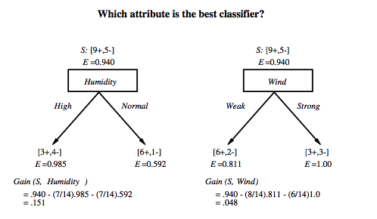
Which attribute is the best classifier?

Slide 13
First step
Which attribute should be tested at the root?
Which attribute should be tested at the root?
Gain(S, Outlook) = 0.246
Gain(S, Humidity) = 0.151
Gain(S, Wind) = 0.048
Gain(S, Temperature) = 0.029
Outlook provides the best prediction for the target
Lets grow the tree
add to the tree a successor for each possible value of Outlook
partition the training samples according to the value of Outlook

Slide 14
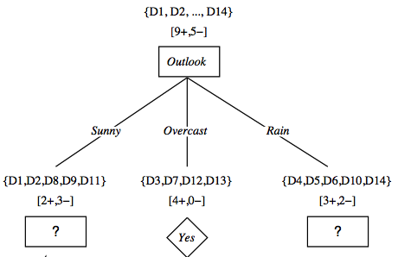
After first step

Slide 15
Second step
Working on Outlook=Sunny node:
Gain(S_{Sunny}, Humidity) = 0.970 − 3/5 × 0.0 − 2/5 × 0.0 = 0.970
Gain(S_{Sunny}, Wind) = 0.970 − 2/5 × 1.0 − 3.5 × 0.918 = 0 .019
Gain(S_{Sunny}, Temp.) = 0.970 − 2/5 × 0.0 − 2/5 × 1.0 − 1/5 × 0.0 = 0.570
Humidity provides the best prediction for the target
Lets grow the tree
add to the tree a successor for each possible value of Humidity
partition the training samples according to the value of Humidity

Slide 16
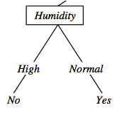
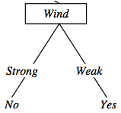
Second and third steps
{D1, D2, D8}
No
{D9, D11}
Yes
{D4, D5, D10}
Yes
{D6, D14}
No

Slide 17
ID3: algorithm
ID3(X, T, Attrs) X: training examples:
T: target attribute (e.g. PlayTennis),
Attrs: other attributes, initially all attributes
Create Root node
If all X's are +, return Root with class +
If all X's are –, return Root with class –
If Attrs is empty return Root with class most common value of T in X
else
A ← best attribute; decision attribute for Root ← A
For each possible value v_{i} of A:
- add a new branch below Root, for test A = v_{i}
- X_{i} ← subset of X with A = v_{i}
- If X_{i} is empty then add a new leaf with class the most common value of T in X
else add the subtree generated by ID3(X_{i}, T, Attrs − {A})
return Root

Slide 18
Thank You!
In our next segment: Issues in Decision Trees

Slide 19
Classification Model II Issues in Decision Trees
Dr. Sugata Ghosal
CSIS Off-Campus Faculty
BITS Pilani

Slide 20
Segment Content
Overfitting
Reduced error pruning
Rule post-pruning
Extensions
Problem with Information Gain measure
Continuous valued attributes
Handling training examples with missing attribute values

Slide 21
Prefer shorter hypotheses: Occam's razor
Why?
Occam's razor says that when presented with competing hypotheses that make the same predictions, one should select the solution which is simple“
Arguments in favor
There are fewer short hypotheses than long ones
If a short hypothesis fits data unlikely to be a coincidence
Elegance and aesthetics
Arguments against
Not every short hypothesis is a reasonable one.

Slide 22
Issues in decision trees learning
Overfitting
Reduced error pruning
Rule post-pruning
Extensions
Problem with Information Gain measure
Continuous valued attributes
Handling training examples with missing attribute values
Notes:
L'overfitting può succedere quando c' è rumore nei dati.

Slide 23
Example
D15 Sunny Hot Normal Strong No
Notes:
L’ esempio D15 è sbagliato, introduce rumore nei dati.

Slide 24
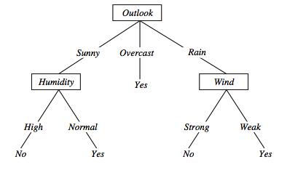
Overfitting in decision trees
〈Outlook=Sunny, Temp=Hot, Humidity=Normal, Wind=Strong, PlayTennis=No 〉
This new example causes splitting of second leaf node.
Notes:
The example shows that noise can lead to overfitting.
Overfitting without noise is also possible, especially when classifcation decision on the leafs are based on few examples. Uniform classification may be a coincidence.
This is a potential cause of overfitting.
Overfitting is a significant problem for DT, reducing the accuracy to 10-25% on many problems.

Slide 25
Avoid overfitting in Decision Trees
Two strategies:
Stop growing the tree earlier, before perfect classification
Leaf nodes are impure
Allow the tree to overfit the data, and then post-prune the tree
Training and validation set
split the training in two parts (training and validation) and use validation to assess the utility of post-pruning
Reduced error pruning
Rule post pruning
Notes:
Usando tutti dati di training, un test statistico può predire l’ influenza delle decisioni se espandere (o potare) sulle prestazioni su tutto X.
Minimum description length principle, un principio di compattezza della rappresentazione.

Slide 26
Reduced-error pruning
Each node is a candidate for pruning
Pruning consists in removing a subtree rooted in a node
the node becomes a leaf and is assigned the most common classification
Nodes are removed only if the resulting tree performs no worse on the validation set.
Nodes are pruned iteratively
at each iteration the node whose removal increases accuracy the most on the validation set is pruned.
Pruning stops when no pruning increases accuracy
Notes:
Potatura sulla base di errori ridotti, valutati sul validation set.

Slide 27
Rule post-pruning
Create the decision tree from the training set
Convert the tree into an equivalent set of rules
Each path corresponds to a rule
Each node along a path corresponds to a pre-condition
Each leaf classification to the post-condition
Prune (generalize) each rule by removing those preconditions whose removal improves accuracy
over validation set
Sort the rules in estimated order of accuracy, and consider them in sequence when classifying new instances

Slide 28
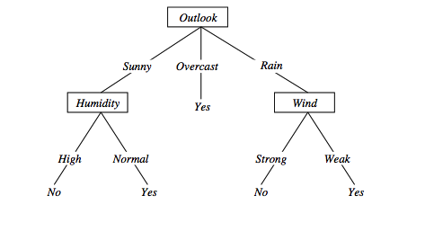
Converting to rules
(Outlook=Sunny)∧(Humidity=High) ⇒ (PlayTennis=No)

Slide 29
Rule Post-Pruning
Convert tree to rules (one for each path from root to a leaf)
For each antecedent in a rule, remove it if error rate on validation set does not decrease
Sort final rule set by accuracy
Outlook=sunny ^ humidity=high -> No
Outlook=sunny ^ humidity=normal -> Yes
Outlook=overcast -> Yes
Outlook=rain ^ wind=strong -> No
Outlook=rain ^ wind=weak -> Yes
Compare first rule to:
Outlook=sunny->No
Humidity=high->No
Calculate accuracy of 3 rules based on validation set and pick best version.

Slide 30
Why converting to rules?
Each distinct path produces a different rule
a condition removal may be based on a local (contextual) criterion.
Node pruning is global and affects all the rules
Provides flexibility of not removing entire node
In rule form, tests are not ordered and there is no book-keeping involved when conditions (nodes) are removed
Converting to rules improves readability for humans

Slide 31
Problems with information gain
Natural bias of information gain: it favors attributes with many possible values.
Consider the attribute Date in the PlayTennis example.
Date would have the highest information gain since it perfectly separates the training data.
It would be selected at the root resulting in a very broad tree
Very good on the training, this tree would perform poorly in predicting unknown instances.
Leading to overfitting.
The problem is that the partition is too specific, too many small classes are generated.
We need to look at alternative measures …

Slide 32
An alternative measure: Gain Ratio
c |S_{i} | |S_{i} |
SplitInformation(S, A) ≡ − Σ log₂ i=1 |S | |S |
S_{i} are the sets obtained by partitioning on value i of A
SplitInformation measures the entropy of S with respect to the values of A.
The more uniformly dispersed the data the higher it is.
Gain(S, A)
GainRatio(S, A) ≡
SplitInformation(S, A)
GainRatio penalizes attributes that split examples in many small classes such as Date.
Let |S |=n, Date splits examples in n classes
SplitInformation(S, Date)= −[(1/n log₂ 1/n)+…+ (1/n log₂ 1/n)]= −log₂1/n =log₂n
Compare with A, which splits data in two even classes:
SplitInformation(S, A)= − [(1/2 log₂1/2)+ (1/2 log₂1/2) ]= − [− 1/2 −1/2]=1
Notes:
2^{-x} = 1/2^{x}

Slide 33
Dealing with continuous-valued attributes
Given a continuous-valued attribute A, dynamically create a new attribute A_{c}
A_{c} = True if A < c, False otherwise
How to determine threshold value c ?
Example. Temperature in the PlayTennis example
Sort the examples according to Temperature
Temperature 40 48 | 60 72 80 | 90
PlayTennis No No 54 Yes Yes Yes 85 No
Determine candidate thresholds by averaging consecutive values where there is a change in classification: (48+60)/2=54 and (80+90)/2=85

Slide 34
Handling missing values training data
How to cope with the problem that the value of some attribute may be missing?
The strategy -- use other examples to guess attribute
Assign the value that is most common among the training examples at the node
Assign a probability to each value, based on frequencies, and assign values to missing attribute, according to this probability distribution

Slide 35
Applications
Suited for following classification problems:
Applications whose Instances are represented by attribute-value pairs.
The target function has discrete output values
Disjunctive descriptions may be required
The training data may contain missing attribute values
Real world applications
Biomedical applications
Manufacturing
Banking sector
Make-Buy decisions

Slide 36
Thank You!
In our next segment: Ensembles

Slide 37
Classification Model II Ensemble Methods
Dr. Sugata Ghosal
CSIS Off-Campus Faculty
BITS Pilani

Slide 38
Segment Content
Ensemble of Classifiers
Why and when ensembles work?
Bagging technique

Slide 39
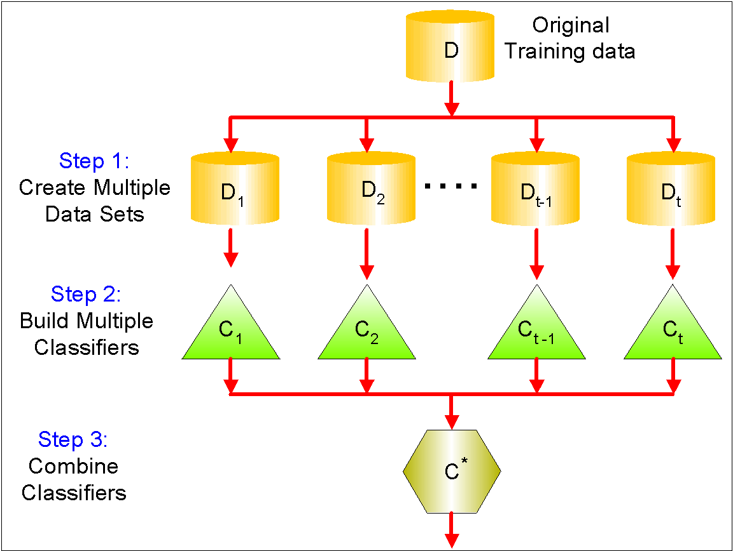
Ensemble Methods
Use multiple learning algorithms to obtain better predictive performance than could be obtained from any of the constituent learning algorithms alone
Construct a set of classifiers from the training data
Predict class label of test records by combining the predictions made by multiple classifiers
Tend to reduce problems related to overfitting of the training data.

Slide 40
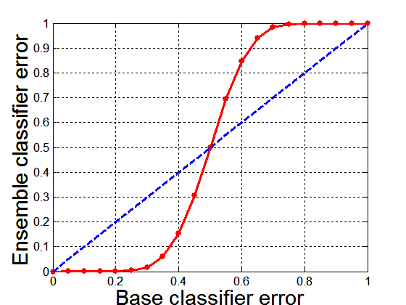
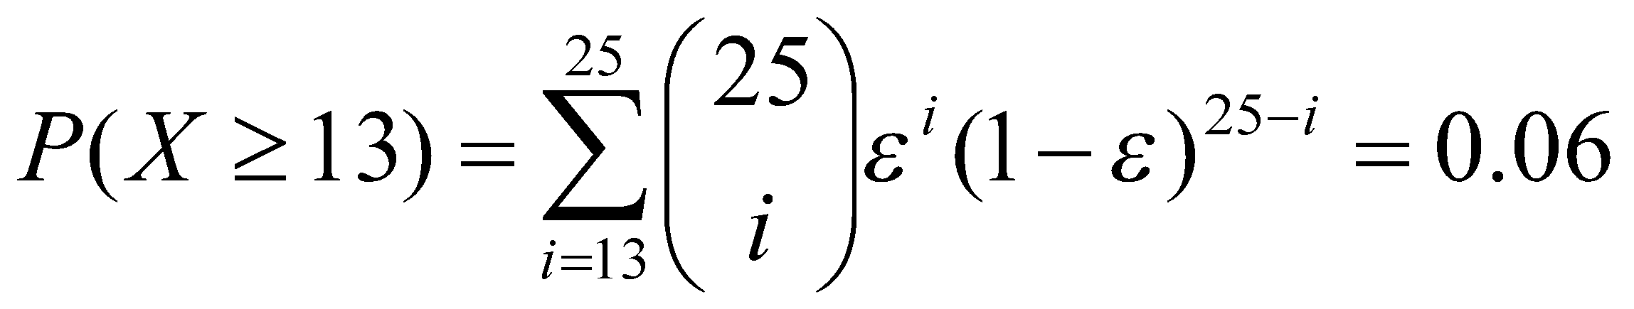
Why Ensemble Methods work?
25 base classifiers
Each classifier has error rate, ε = 0.35
If base classifiers are identical, then the ensemble will misclassify the same examples predicted incorrectly by the base classifiers depicted by dotted line
Assume errors made by classifiers are uncorrelated
ensemble makes a wrong prediction only if more than half of the base classifiers predict incorrectly
Probability that the ensemble classifier makes a wrong prediction

Slide 41
When does Ensemble work?
Ensemble classifier performs better than the base classifiers when error is smaller than 0.5
Necessary conditions for an ensemble classifier to perform better than a single classifier
Base classifiers should be independent of each other
Base classifiers should do better than a classifier that performs random guessing
Ensemble Methods work best with unstable base classifiers
Classifiers that are sensitive to minor perturbations in training set, due to high model complexity
Examples: Unpruned decision trees, ANNs, …
Low Bias in finding optimal decision boundary
High Variance for minor changes in training set or model selection procedure

Slide 42
Bias-Variance Decomposition
Analogous problem of reaching a target y by firing projectiles from x (regression problem)
For classification, generalization error or model m can be given by:

Slide 43
Bias-Variance Trade-off and Overfitting
Ensemble methods try to reduce the variance of complex models (with low bias) by aggregating responses of multiple base classifiers
Overfitting
Underfitting

Slide 44
Examples
Simple Ensemble Techniques
Example: Movie rating
Max Voting
The result of max voting would be
Rating by 5 friends: 5 4 5 4 4
Averaging
(5+4+5+4+4)/5 = 4.4 Final rating
Weighted Average
Weight-0.23 0.23 0.18 0.18 0.18
The result is calculated as [(5*0.23) + (4*0.23) + (5*0.18) + (4*0.18) + (4*0.18)] = 4.41.

Slide 45
Constructing Ensemble Methods
Manipulate data distribution
Example: bagging
Manipulate input features
Example: random forests
By manipulating class labels
Example: error-correcting output coding
By manipulating learning algorithm
Example: injecting randomness in ANN or decision tree

Slide 46
Bagging
Bootstrap AGGregatING
Technique uses these subsets (bags) to get a fair idea of the distribution (complete set).
The size of subsets created for bagging may be less than the original set.
Bootstrapping is a sampling technique in which we create subsets of observations from the original dataset, with replacement.
When you sample with replacement, items are independent.
One item does not affect the outcome of the other.
You have 1/7 chance of choosing the first item and a 1/7 chance of choosing the second item.
If the two items are dependent, or linked to each other.
When you choose the first item, you have a 1/7 probability of picking a item.
Assuming you don’t replace the item, you only have six items to pick from. That gives you a 1/6 chance of choosing a second item, and so on …

Slide 47
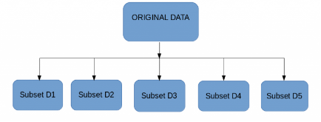
Bagging
Multiple subsets are created from the original dataset, selecting observations with replacement.
A base model (weak model) is created on each of these subsets.
The models run in parallel and are independent of each other.
The final predictions are determined by combining the predictions from all the models.

Slide 48
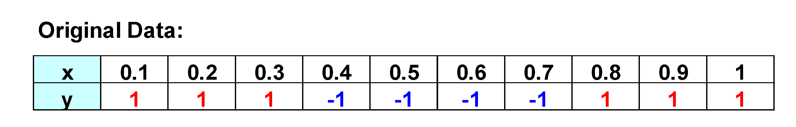
Bagging Example
Consider this one-dimensional dataset
Classifier is a decision stump
Decision rule: x ≤ k versus x > k
Split point k is chosen based on entropy
x ≤ k
True
False
y_{left}
y_{right}

Slide 49
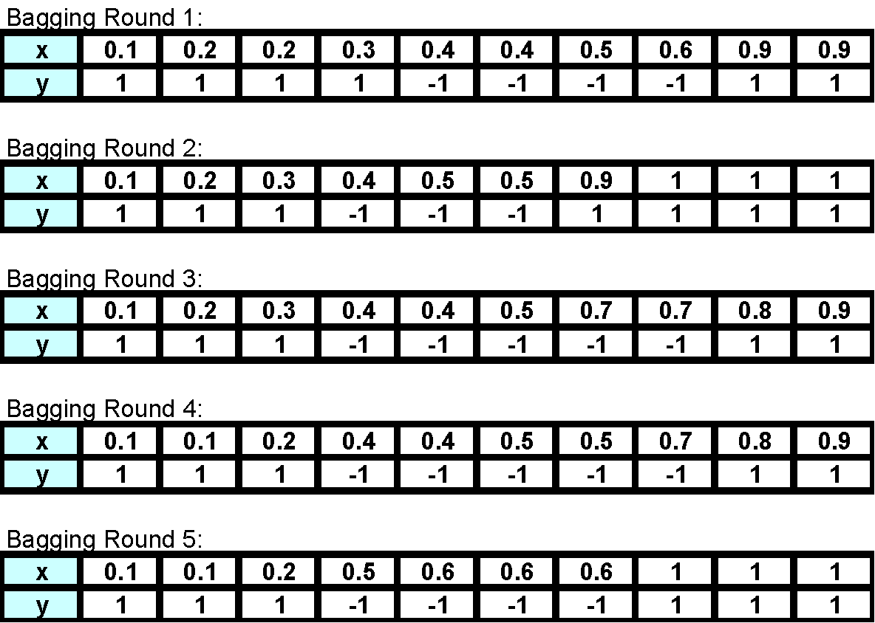
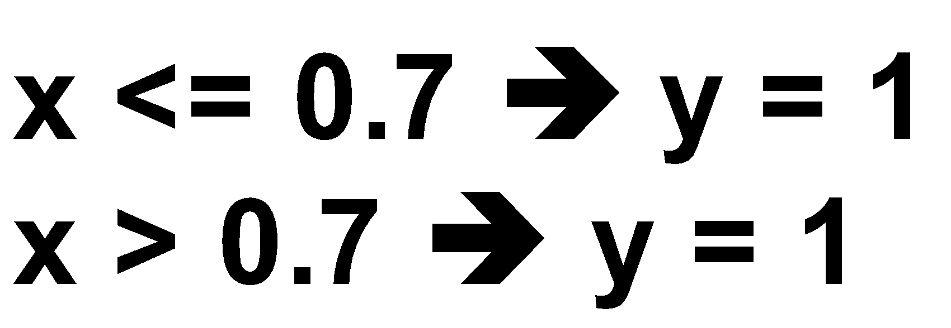
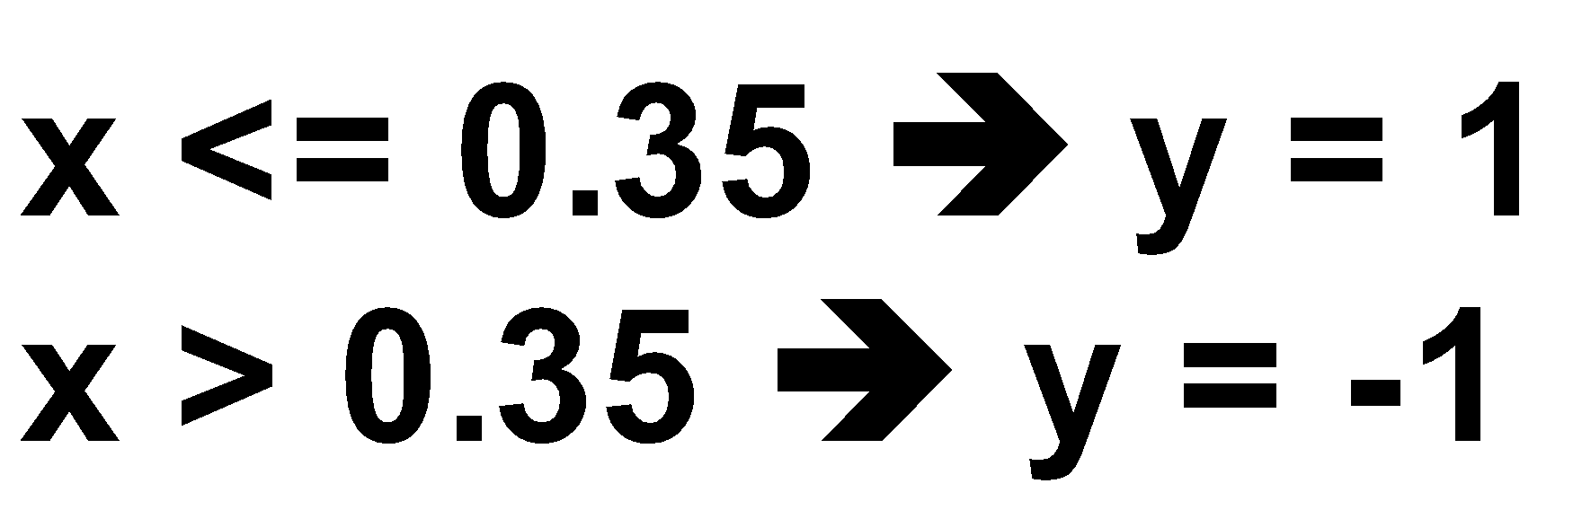
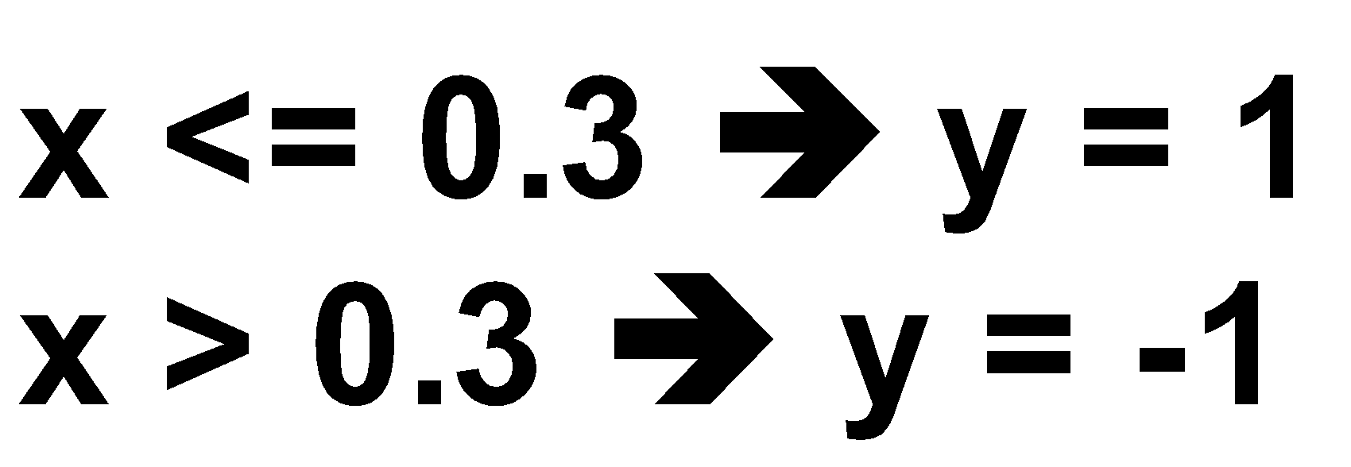
Bagging Example

Slide 50

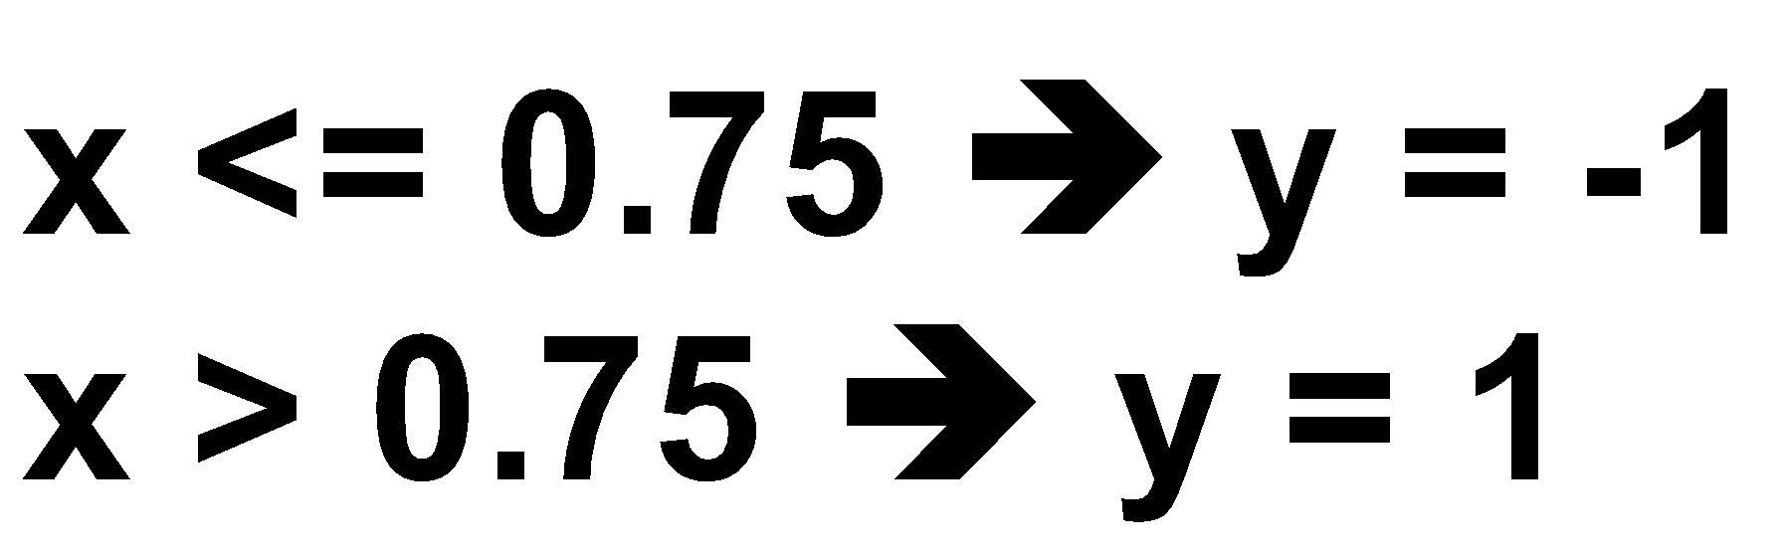
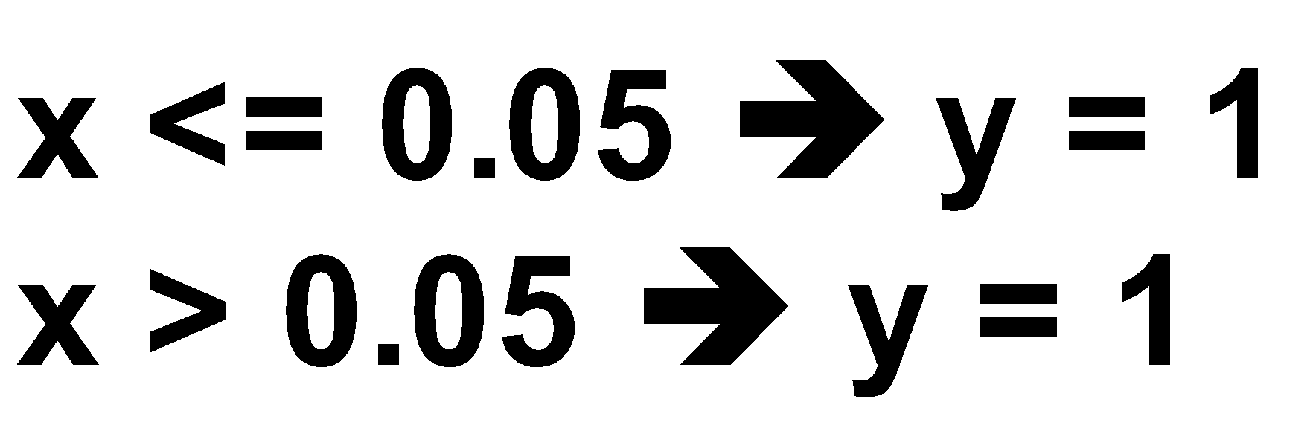
Bagging Example

Slide 51
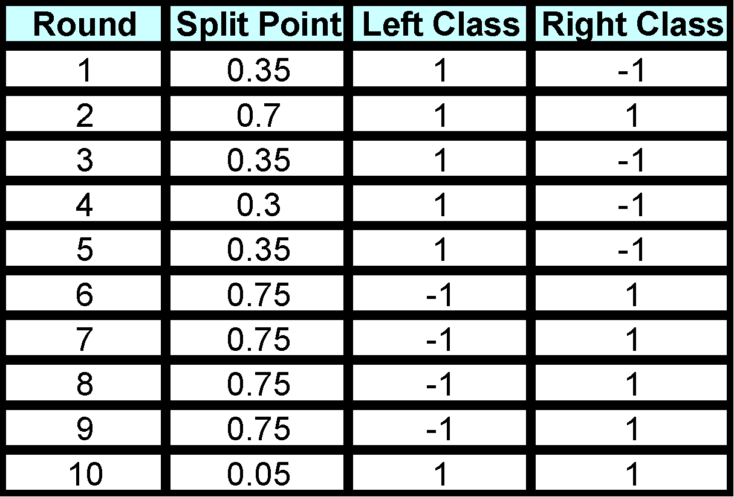
Bagging Example
Summary of Training set

Slide 52
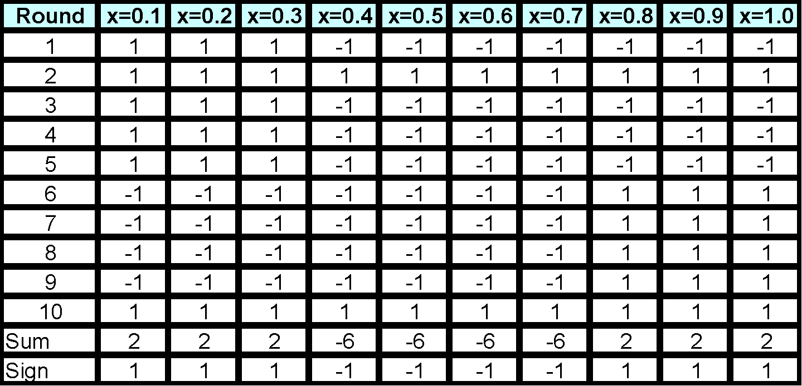
Bagging Example
Assume test set is the same as the original data
Use majority vote to determine class of ensemble classifier
Predicted Class

Slide 53
Bagging Algorithm

Slide 54
Thank You!
In our next segment: Boosting

Slide 55
Classification Model II Boosting
Dr. Sugata Ghosal
CSIS Off-Campus Faculty
BITS Pilani

Slide 56
Segment Content
Boosting Technique
AdaBoost
Random Forest

Slide 57
Boosting
An iterative procedure to adaptively change distribution of training data by focusing more on previously misclassified records
Initially, all N records are assigned equal weights (for being selected for training)
Unlike bagging, weights may change at the end of each boosting round

Slide 58
Boosting
An iterative procedure to adaptively change distribution of training data by focusing more on previously misclassified records
Initially, all N records are assigned equal weights (for being selected for training)
Unlike bagging, weights may change at the end of each boosting round
Records that are wrongly classified will have their weights increased in the next round
Records that are classified correctly will have their weights decreased in the next round
Example 4 is hard to classify
Its weight is increased, therefore it is more likely to be chosen again in subsequent rounds

Slide 59
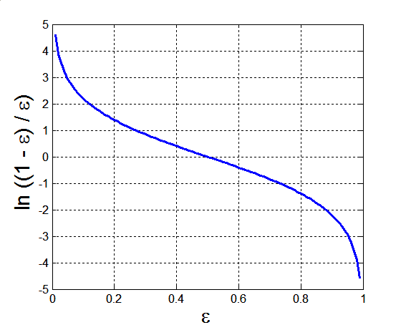
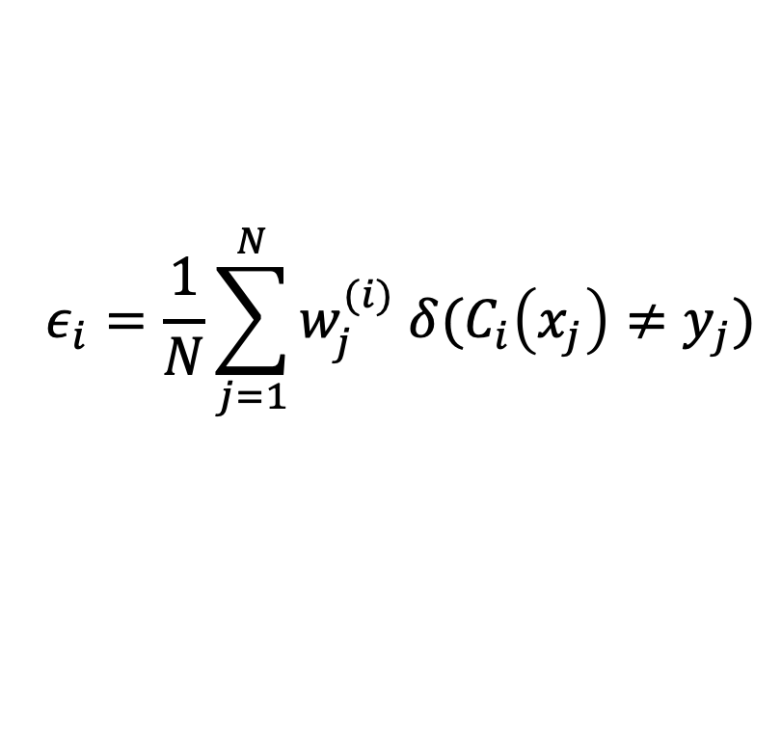
AdaBoost
Base classifiers: C₁, C₂, …, C_{T}
Error rate of a base classifier:
Importance of a classifier

Slide 60
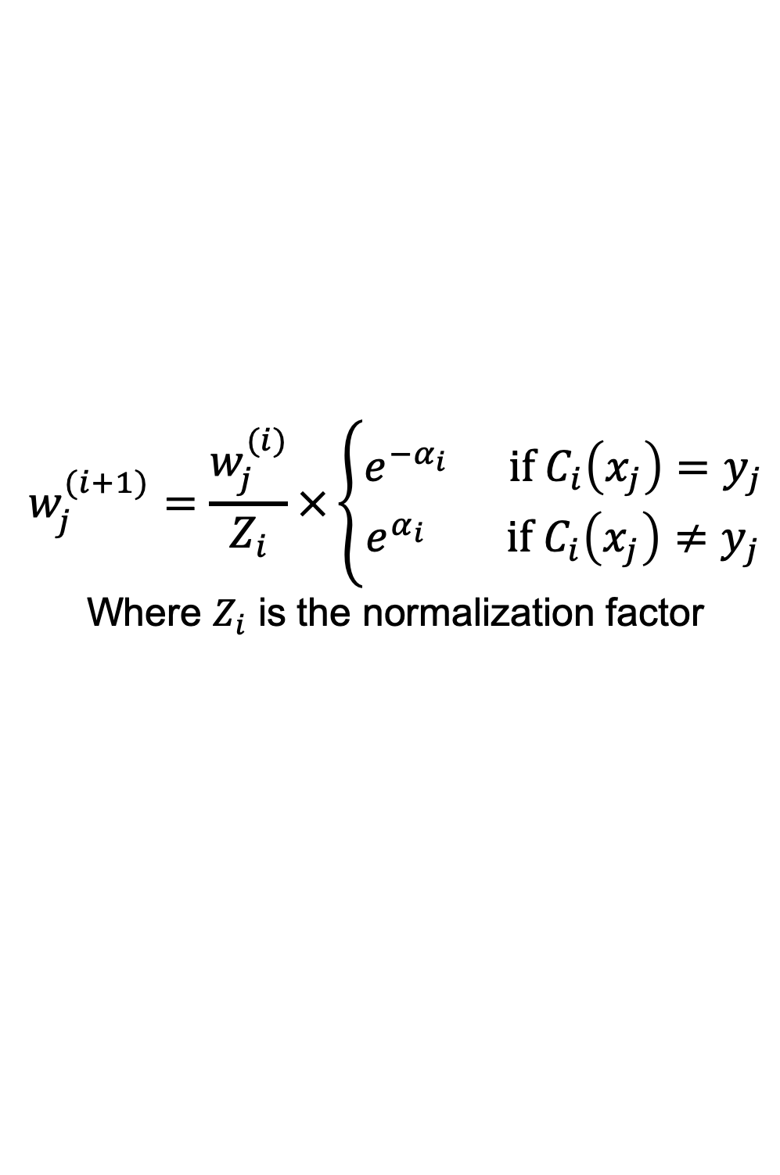
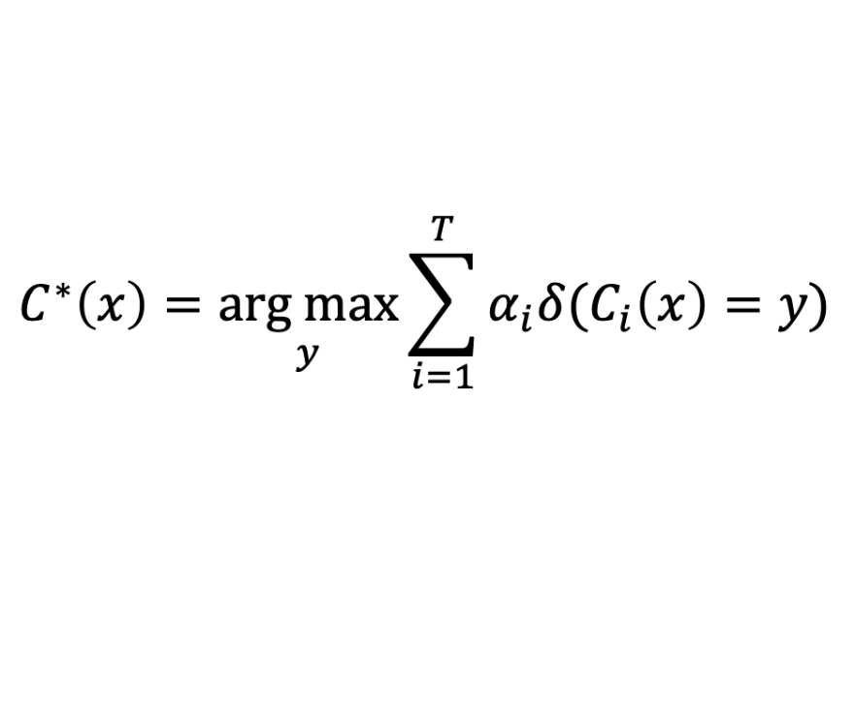
AdaBoost Algorithm
Weight update for j-th training data at i-th step
If any intermediate rounds produce error rate higher than 50%, the weights are reverted back to 1/n and the resampling procedure is repeated
Classification
Equation 1

Slide 61
AdaBoost Algorithm
1

Slide 62
AdaBoost Example
Consider this one dimensional dataset
Classifier is a decision stump
Decision rule: x ≤ k versus x > k
Split point k is chosen based on entropy
x ≤ k
True
False
y_{left}
y_{right}

Slide 63
AdaBoost Example
Training sets for the first 3 boosting rounds
Summary:

Slide 64
AdaBoost Example
Weights
Classification
Predicted Class

Slide 65
Random Forest
Random Forest is another ensemble machine learning algorithm that follows the bagging technique.
The base estimators in random forest are decision trees.
As in bagging, we build a number of decision trees on bootstrapped training samples
Each time a split in a tree is considered, a random sample of m predictors is chosen as split candidates from the full set of p predictors.
if m = p, then this is bagging.
Decorrelated trees because of bagging and feature randomization.
A decision tree model is fitted on each of the subsets.
The final prediction is calculated by averaging the predictions from all decision trees.
In practice the best values for m and p will depend on the problem, and they should be treated as tuning parameters.
For classification, the default value for m is √p or log₂ (p+1) and the minimum node size is one.
For regression, the default value for m is p/3 and the minimum node size is five.

Slide 66
Random Forest
A decision tree model is fitted on each of the subsets.
The final prediction is calculated by averaging the predictions from all decision trees.
Random forest reduces the variance of unstable base classifiers without negatively impacting the bias
In practice the best values for m and p will depend on the problem, and they should be treated as tuning parameters.
Small values of p ensure lack of correlation
High values of p promotes strong classifiers
For classification, the default value for m is √p or log₂ (d+1) and the minimum node size is one.
For regression, the default value for m is p/3 and the minimum node size is five.

Slide 67
Random Forest
Random Forest is another ensemble machine learning algorithm that follows the bagging technique.
The base estimators in random forest are decision trees.
Unpruned trees, thus unstable classifiers
As in bagging, we build a number of decision trees on bootstrapped training samples
Each time a split in a tree is considered, a random sample of m predictors is chosen as split candidates from the full set of p predictors.
if m = p, then this is bagging
Decorrelated trees because of bagging and feature randomization.

Slide 68
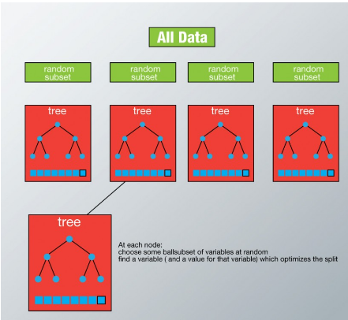
Random Forest

Slide 69
Random Forest Algorithm
For b = 1 to B
Draw a bootstrap sample Z∗ of size N from the training data.
Grow a random-forest tree to the bootstrapped data, by recursively repeating the following steps for each terminal node of the tree, until the minimum node size n_{min} is reached.
Select m variables at random from the p variables.
Pick the best variable/split-point among the m.
Split the node into two daughter nodes. Output the ensemble of trees.
To make a prediction at a new point x we do
For regression: average the results
For classification: majority vote

Slide 70
Characteristics
Advantages
Algorithm can solve both classification and regression problems
Can handle large data set with higher dimensionality.
It can handle thousands of input variables and identify most significant variables
dimensionality reduction
Model outputs Importance of variable, which can be a very handy feature (on some random data set).
Disadvantages
May over-fit datasets that are particularly noisy.
When the number of variables is large, but the fraction of relevant variables is small, random forests are likely to perform poorly when m is small
At each split the chance can be small that the relevant variables will be selected
For example, with 3 relevant and 100 not so relevant variables the probability of any of the relevant variables being selected at any split is ~0.25
Random Forest can feel like a black box approach for statistical modelers
you have very little control on what the model does.
You can at best try different parameters and random seeds!

Slide 71
Thank You!
In our next session: Unsupervised Learning

